Slide 1
COVID Projects
Emily Rhodes
January 27th, 2021

Slide 2
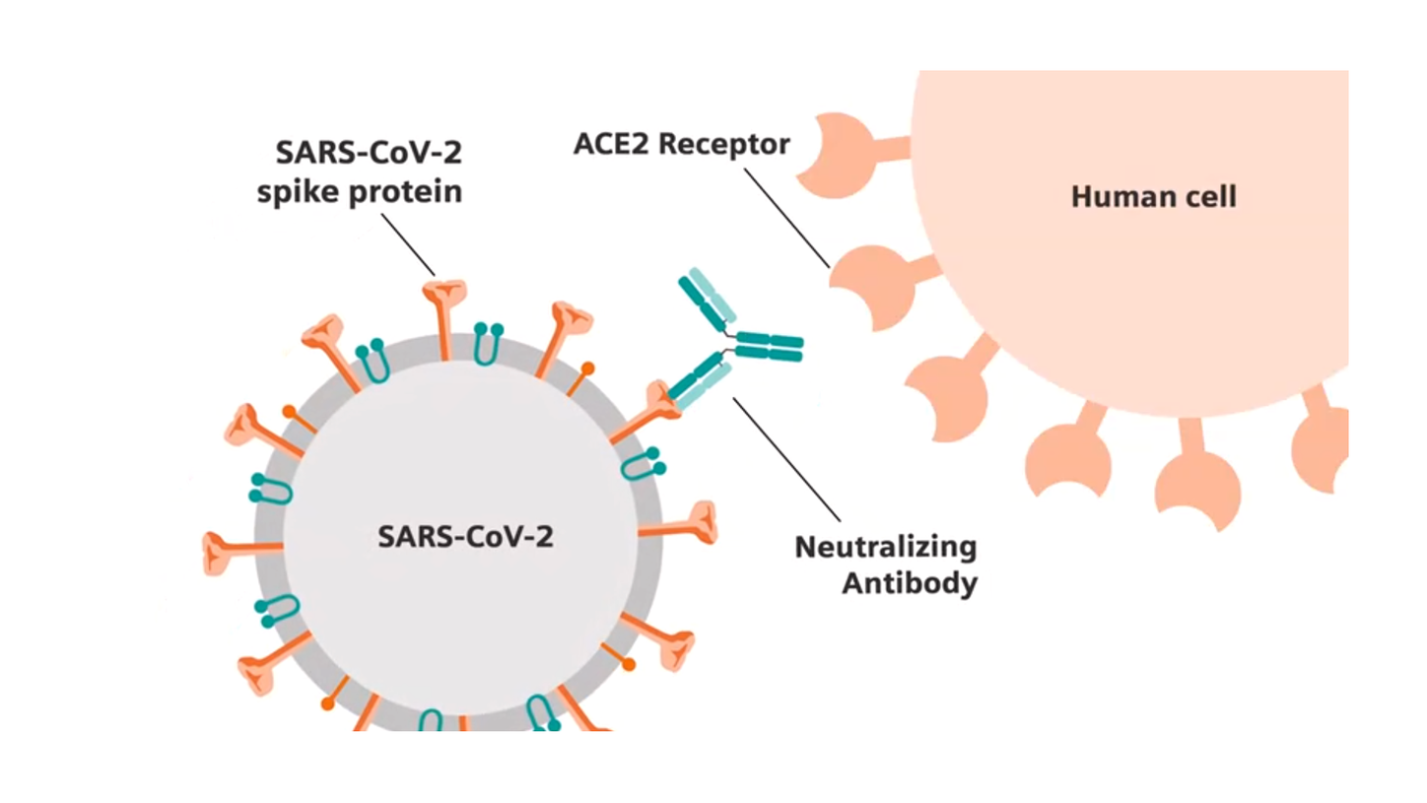
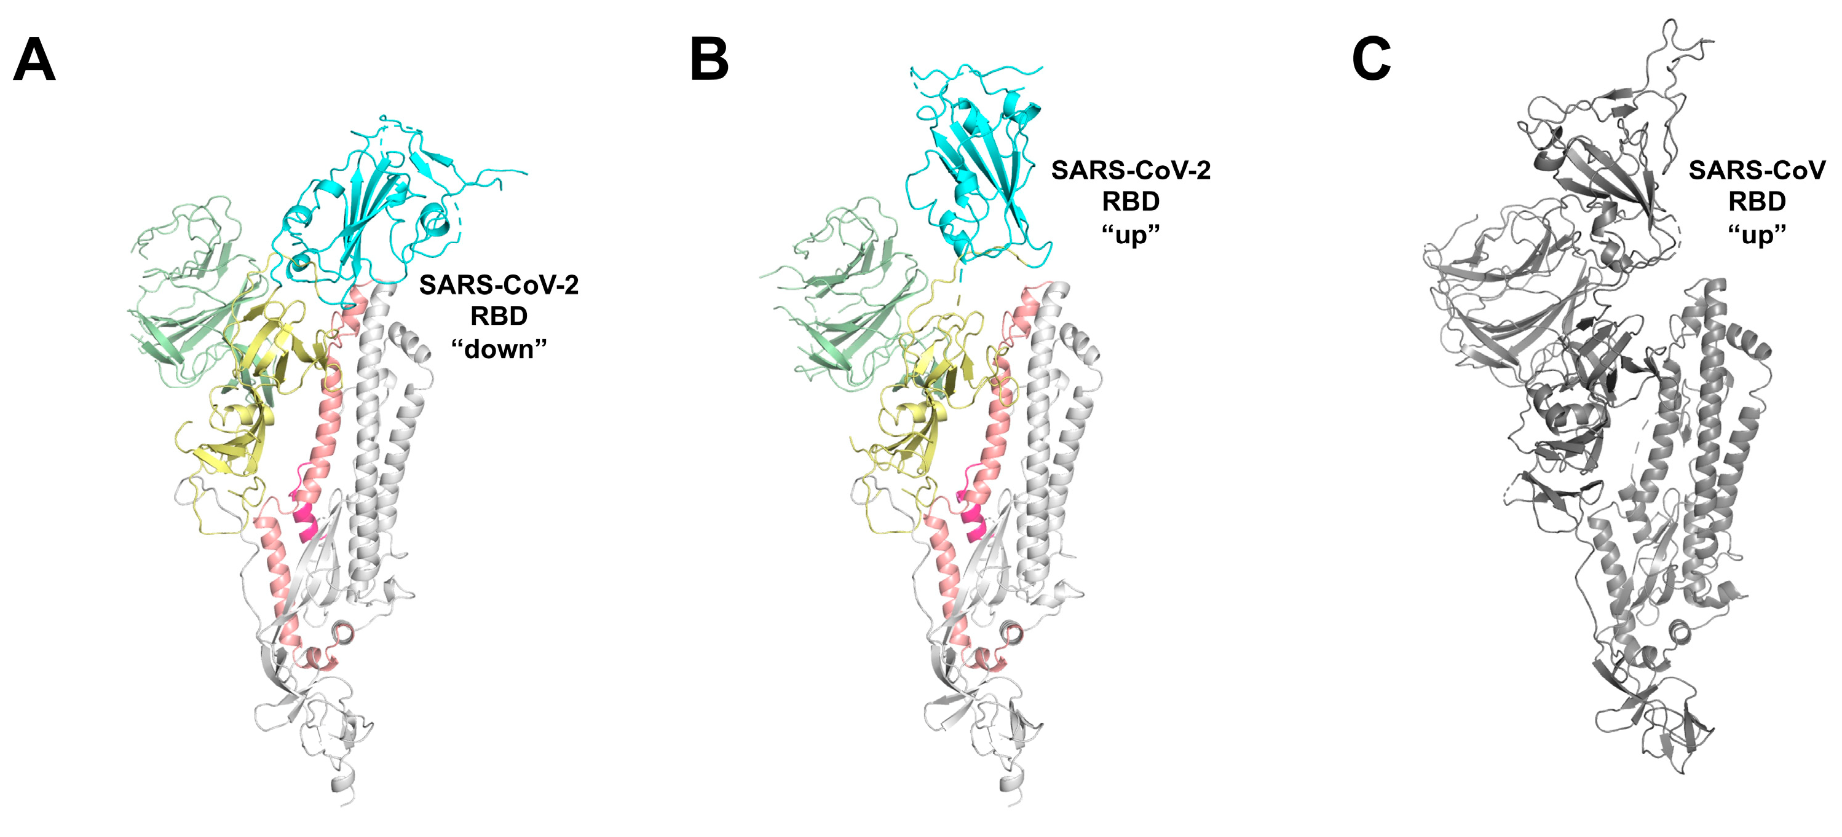
Areas of Investigation
Antibody neutralization cut-off
Understand RBD conformation impact on association rate
Notes:
Antibody neutralization cut-off
Explain what this is
We want to know why this happens & predict it with COVID
Understand RBD conformation impact on association rate

Slide 3
Neutralization Cut-Off
Project 1

Slide 4
Procedure:
Write differential equations to describe the number of antibodies bound to each virus.
Write a function for infectivity that depends on the number of spike proteins bound.
Using the concentrations and times of neutralization provided fit the function for infectivity
Test the model by trying to “predict” neutralization cut-offs for known antibodies and check if they are correct.
Use the model to predict neutralization cut-offs for new antibodies.

Slide 5
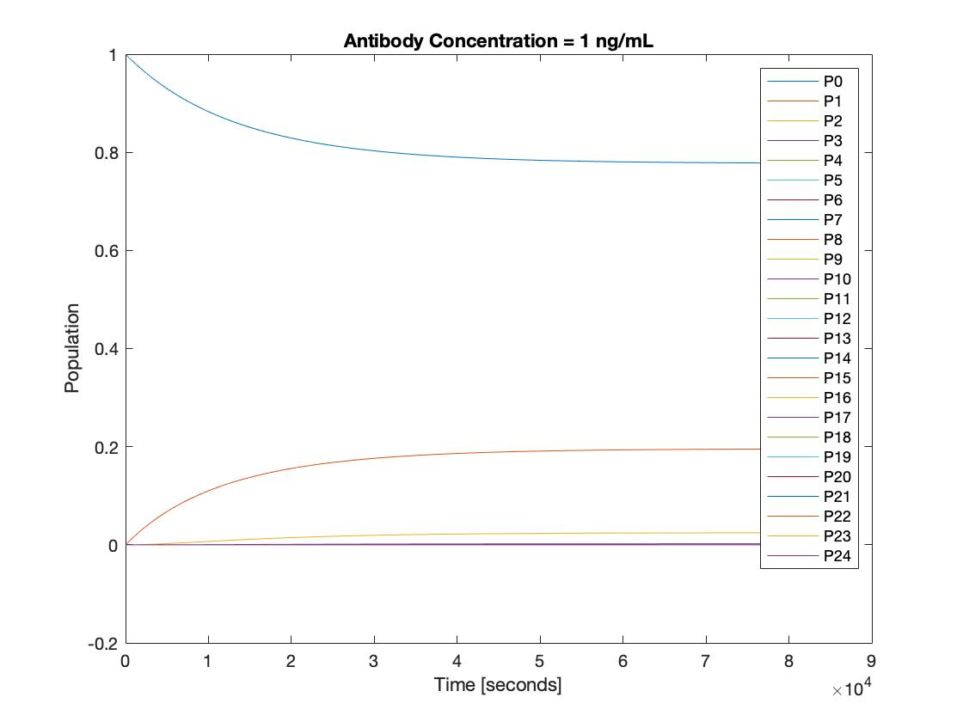
Population of Viruses with Antibodies Bound:
At equilibrium, most viruses have no antibodies bound, but some have 1 out of 24.
Notes:
Assumed infectivity was linearly related to spikes bound

Slide 6
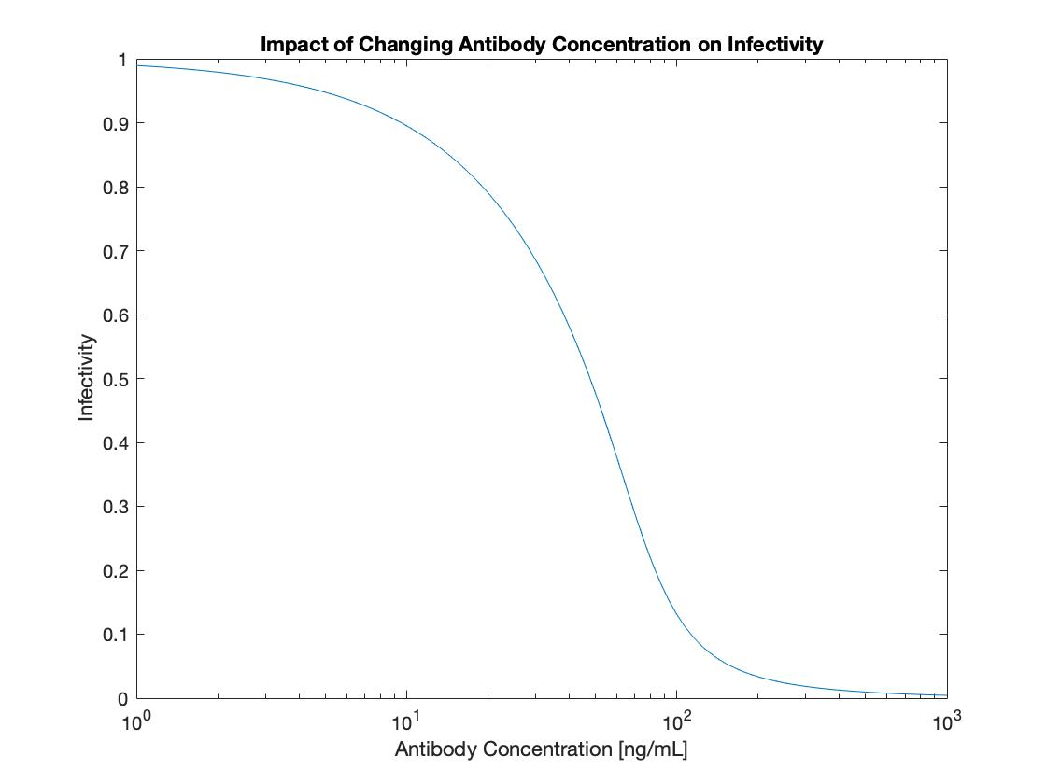
Original Model of Infectivity:
Original model of infectivity predicted it would drop at around 100 ng/mL. Does not agree with experiments.

Slide 7
Infectivity vs. Neutralization (Traditional)
“During single-hit neutralization only viruses without any antibody molecules bound will be infectious. Remaining infectivity of virus will decrease linearly when plotted on a logarithmic scale against the number of antibodies per virus. The curve will pass through e⁻ ¹, or 37% remaining infectivity, when a single antibody is bound and e⁻ ², 14% remaining infectivity, when two antibodies are bound (Fig. 3A).”
My assumption that infectivity was linearly related to antibodies bound, was wrong.

Slide 8
Infectivity vs. Neutralization
TRIM21 exerts incremental neutralization whereby each antibody that binds contributes to neutralization and that the magnitude of this contribution is in turn determined by the levels of TRIM21
Key Papers that I am reading:
R. Dulbecco, M. Vogt, A. Strickland Virology (1956)
W. A. Mcewan, L. C. James Progress in Molecular Biology and Translational Science (2015)
P. J. Klasse, Q. J. Sattentau Journal of General Virology (2002)
I am writing a function for infectivity based on the literature.
Notes:
Send papers to Tim

Slide 9
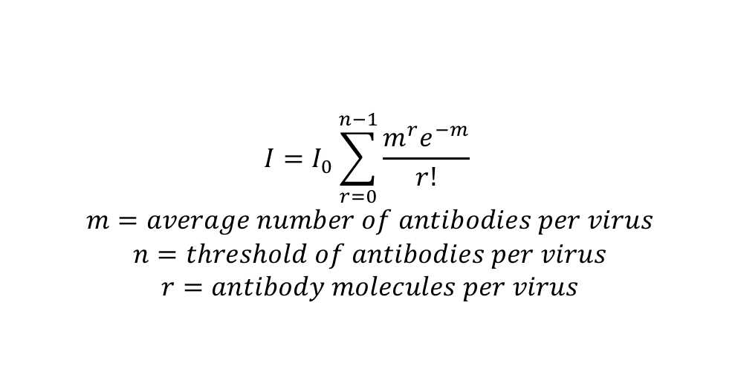
Function for Infectivity
All or Nothing (First order kinetics)
Incremental Neutralization
$$I=I_{0}\sum_{r=0}^{n−1}{\frac{m^{r}e^{−m}}{r!}}$$
$$m=average number of antibodies per virus$$
$$n=threshold of antibodies per virus$$
$$r=antibody molecules per virus$$
Notes:
IC50 – 50% as infectious as control, IC80 – 20% as infectious as control

Slide 10
How do I account for “non-neutralizable” viruses?
The addition of high concentrations of antibody, or prolonged incubation with excess concentrations of antibody, frequently results in a fraction of viruses that remain resistant to neutralization. These “non-neutralizable” viruses are referred to as the persistent fraction.

Slide 11
Procedure:
Write differential equations to describe the number of antibodies bound to each virus.
Write a function for infectivity that depends on the number of spike proteins bound.
Using the concentrations and times of neutralization provided fit the function for infectivity
Test the model by trying to “predict” neutralization cut-offs for known antibodies and check if they are correct.
Use the model to predict neutralization cut-offs for new antibodies.

Slide 12
RBD Conformation Impact on Association Rate
Project 2

Slide 13
Procedure
Find the spike protein in 4 different states: 0 up, 1 up, 2 up, 3 up and align it to the antibody
Determine the association rate corresponding to each of these states
Model affinity maturation of B cells where the antigens are the spike proteins in different conformations.
Show how the different conformations impact affinity maturation.
Apply this theory to other strains of COVID.
Notes:
Pamela Bjorkman - identifying 4 major epitopes using cryo-EM; CalTech (Cell 2020)
Affinity maturation – unique to our lab; be able to show
*Think about this more*
Mutagenesis for RBD: bind ACE2 but no longer be recognized by antibodies
Find something general that can be used across Corona viruses
PROSS – calculated the structures and designs for spikes
Effect of mutation on association rates
Real sequences – how do antibodies evolve
Determination of binding affinity upon mutation for type I dockerin–cohesin complexes from Clostridium thermocellum and Clostridium cellulolyticum using deep …
CA Kowalsky, TA Whitehead
Proteins: Structure, Function, and Bioinformatics 84 (12), 1914-1928

Slide 14
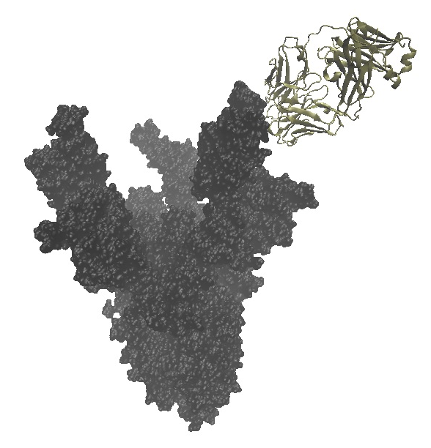
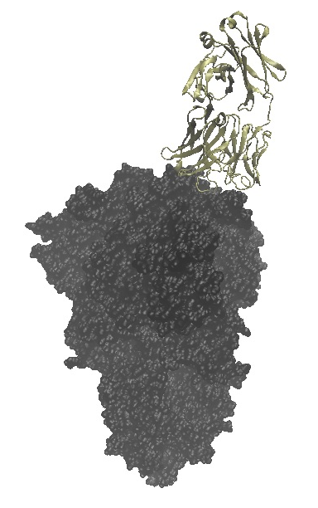
3 up
0 up
Notes:
Look at different antibodies – find association rates; average

Slide 15
Procedure
Find the spike protein in 4 different states: 0 up, 1 up, 2 up, 3 up and align it to the antibody
Determine the association rate corresponding to each of these states
Model affinity maturation of B cells where the antigens are the spike proteins in different conformations.
Show how the different conformations impact affinity maturation.
Apply this theory to other strains of COVID.

Slide 16
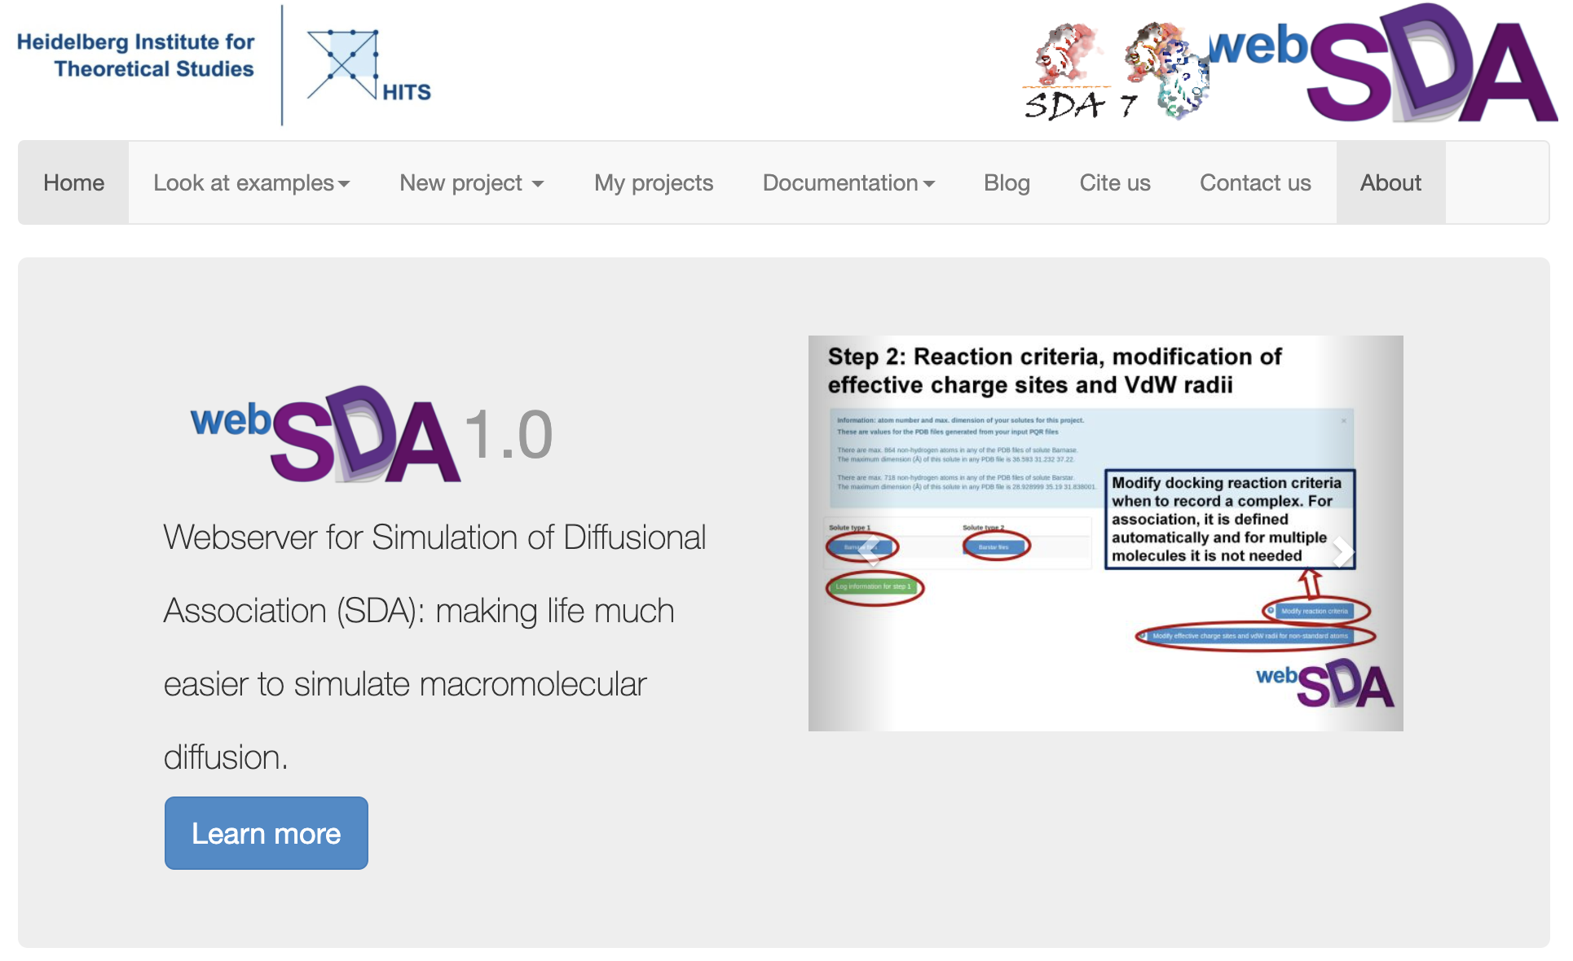
Notes:
Ian Willson; Which antibodies bind to which epitopes - dock the antibodies to which epitope?
Do simulations of the mutants

